Slide 1

A COMPARISON OF TRANSFORMER AND LSTM ENCODER DECODER MODELS FOR ASR
By mahsa Massoud & omid vaheb
Neural networks and deep learning

Slide 2
Introduction
using a Transformer encoder decoder-attention model needs less time compared to LSTM
Transformer is more stable but also more overfitting
Better positional encoding by using 2 initial LSTM layer
Data Augmentation helps improve Transformer and LSTM, 33% and 15% respectively
Best performance by using TED-LIUM-v2
The encoder-decoder attention model is the main focus
Overtaking the hybrid approach if they trained on moderate amount of data
Transformer Model
LSTM
CNN

Slide 3
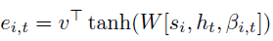
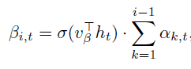

The motivation for self-attention is two-fold:
It allows for more direct information flow across the whole sequence(more direct gradient flow)
Faster training
LSTM-BASED ASR BASELINE:
consists of a stacked bidirectional LSTM encoder, with max-pooling in time operations between BLSTM layers
use the MLP attention in the decoder the attention energies $e_{i,t}$ for encoder time-step t and decoder step i are defined as:
The attention weight feedback :
The attention weights :

Slide 4
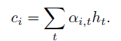

The attention context vector:
The decoder state is a recurrent function implemented as : $s_{i}=LSTMCell(s_{i−1},y_{i−1},c_{i−1})$
The final prediction probability :
Pretraining and Initial convolutional network:
Start with a small encoder and grow it step by step
learning rate warmup and scheduling of regularization(drop out and label smoothing)
It helps to have a larger batch-size (or accumulated gradient)
Making convergence initially more stable and easier
convergence dose not occur without pretraining( though too much hurts performance so it needs tuning)
adding convolutional layers as the initial encoder layers, directly on the features, before the BLSTM layers
It made convergence more unstable but increased overall performance in some cases

Slide 5
Decoupled decoder LSTM (for faster training)
Only depends on ground truth instead of attention context
allows for the direct use of very fast LSTM
Use dot-attention
More overfitting in these models(like transformers)
performs good, but worse than the LSTM baseline
TRANSFORMER-BASED ASR MODEL
Consists of stacked layers
The encoder : multihead self-attention layer + feedforward layer
Normalization + dropout and residual connection
decoder is similar to the encoder + multi-head attention layer for coupling
Time reduction in the encoder
2 layer of BLSTM + Max-pooling

Slide 6
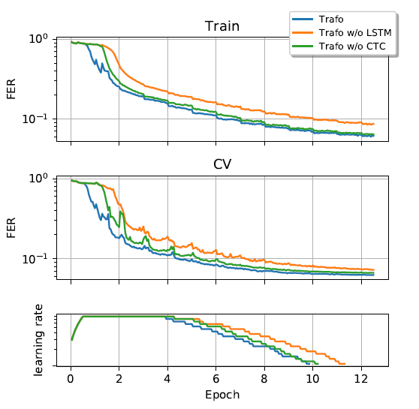
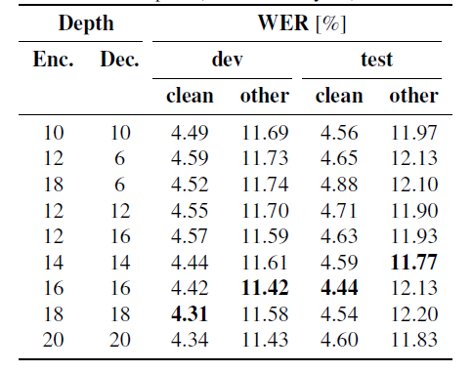
Pretraining
Same as LSTM but more stable and faster initial convergence
As the decoder is deeper now, we let it grow, like the encoder
Linearly increase the hidden dimensions
Disabling does not converge + slower pretraining, decrease the performance
TRAINING BEHAVIOR
Transformer model trains faster and more stable than LSTM
Faster convergence + converge without CTC
Overfit more than LSTM
Comparing different depths(enc+ dec)

Slide 7
DATA AUGMENTATION
randomly apply masking in consecutive frames time axis +consecutive dimensions in the feature axis
the model never sees the original data during training(done on-the-fly) so it reduces overfitting
LANGUAGE MODEL FUSION
train Transformer on the extra text-only data and the transcriptions +apply the language model in decoding by shallow fusion
EXPERIMENTS (limit by a fixed number of epochs):
LibriSpeech (1000 h)
Switchboard (300 h)
TED-LIUM release 2 (200h)

Slide 8
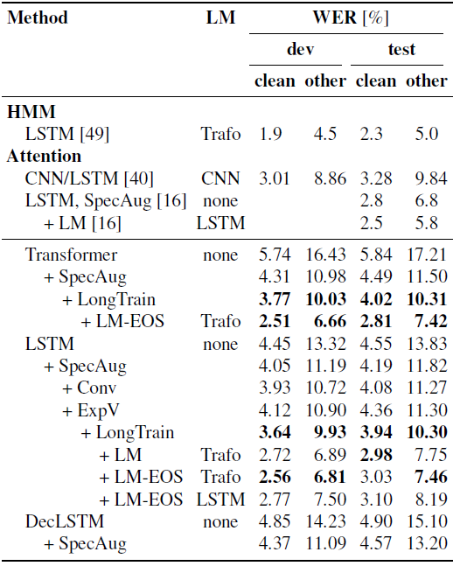
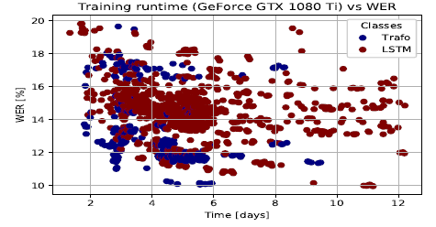
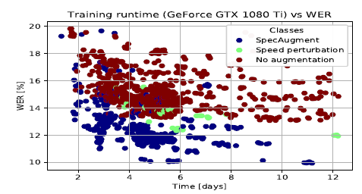
LibriSpeech
For transformer used a hidden dimension of 512 except for the feedforward sublayer of size 2048
number of heads to 8 and stack 12 layers both in the encoder and the decoder + drop out and label smoothing + Adam optimizer
carry out shallow fusion with both LSTM and Transformer attention baseline models

Slide 9
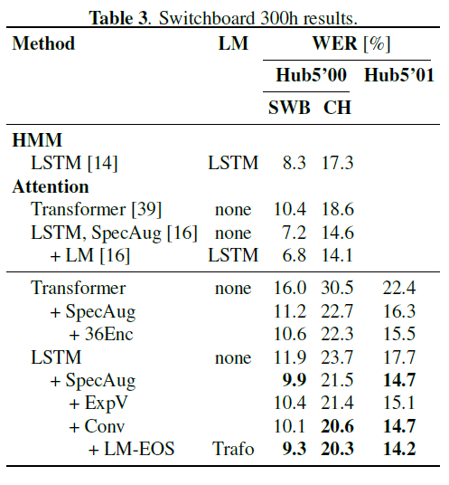
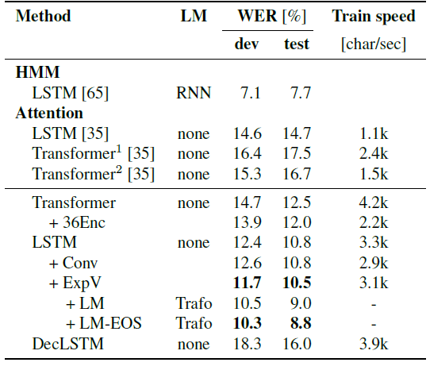
Switchboard
A stack of 12 layers + dropout (0.2) + decreasethe feedforward hidden size to 1024
Varying the number of encoder layers and dropout ratio
For shallow fusion, a 30-layer Transformer language model + feedforward hidden size of 2048 and a self-attention dimension of 512 with 8 head
Improvements from the language model with smaller LM training data is rather limited compared with LibriSpeech result
TED-LIUM release 2
- is very much based on the LibriSpeech setup ( shows stability of Librispeech)+ fast preparing
The transformer used data augmentation like Switchboard
Very high overfitting

Slide 10
COCLUSION
Training transformer models for end-to-end ASR is faster and more stable than LSTM
Problem of overfitting and generalization (Data Augmentation)
Pretraining + time reduction leads to faster convergence + higher performance

